Slide 1
AGENDA
Inventarisatie
HTML + CSS
JavaScript + NodeJS
ECMScript 6
Functioneel programmeren
Frontend tooling

Slide 2

Recommended Site
https://www.freecodecamp.org/news/a-practical-guide-to-learning-front-end-development-for-beginners-da6516505e41/

Slide 3

HTML + CSS

Slide 4
Three Layers of the Web

Slide 5
Keep all of these 3 layers separate !
JavaScript in a .js-file
CSS styling in a .css-file
HTML in a .html-file

Slide 6
HTML + CSS
See:
https://www.w3schools.com/html
And:
https://www.internetingishard.com/html-and-css/basic-web-pages/

Slide 7
JavaScript - language

Slide 8
Requirements
Must have Node installed !
Must have Chrome installed
Use Visual Studio IDE

Slide 9
Agenda JavaScript
What is JavaScript
What is ECMAScript
JavaScript - the Basics

Slide 10
What is JavaScript
Go to:
w3schools.com

Slide 11
JavaScript
Object-oriented
Scripting language
Depends on Browser or Node to execute
Used to make webpages interactive.

Slide 12
Client-side
JavaScript can be executed by browsers
The browser extends JavaScript to:
Manipulate DOM (Data Object Model)
Interact with services from the browser

Slide 13
Server-side JavaScript
Executed by Node
Extended with objects to:
Interact with IO
Interact with Sockets

Slide 14
ECMAScript

Slide 15
ECMAScript
Netscape asked Ecma International to create JavaScript specification
Started in 1996, first release in 1997
Notes:
ECMA = European Computer Manufacturers Association

Slide 16
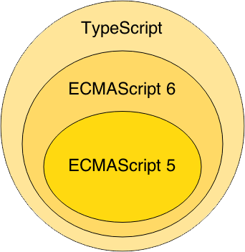

Slide 17
JavaScript
The Basics

Slide 18
Starting point:
MDN Web docs
https://developer.mozilla.org/en-US/docs/Web/JavaScript/Guide/Introduction

Slide 19
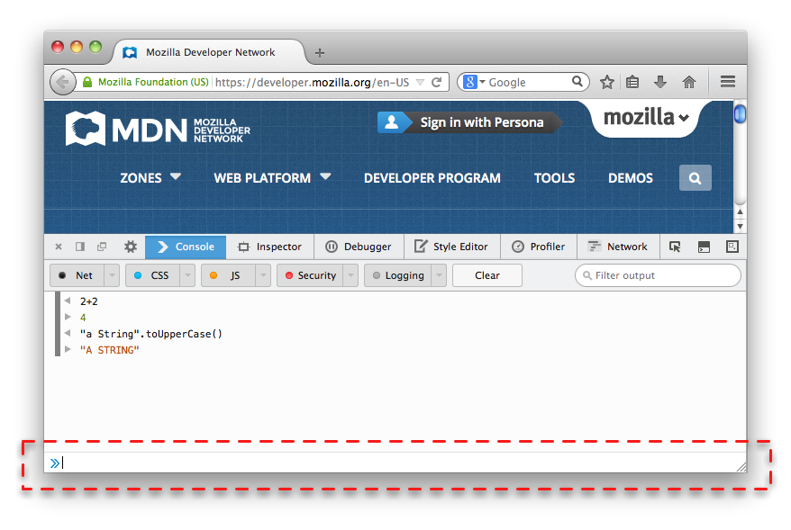
Browser Console
Internet Explorer F12
Firefox Ctrl + Shift + J
Chrome - View > Developer > JavaScript Console
Notes:
Nearly every browser can run JavaScript and most modern browsers now include a JavaScript console that can be used to run snippets of JavaScript code.

Slide 20
Your First JavaScript Program
Type the following in your Browser Console:
console.log("Hello World!");

Slide 21
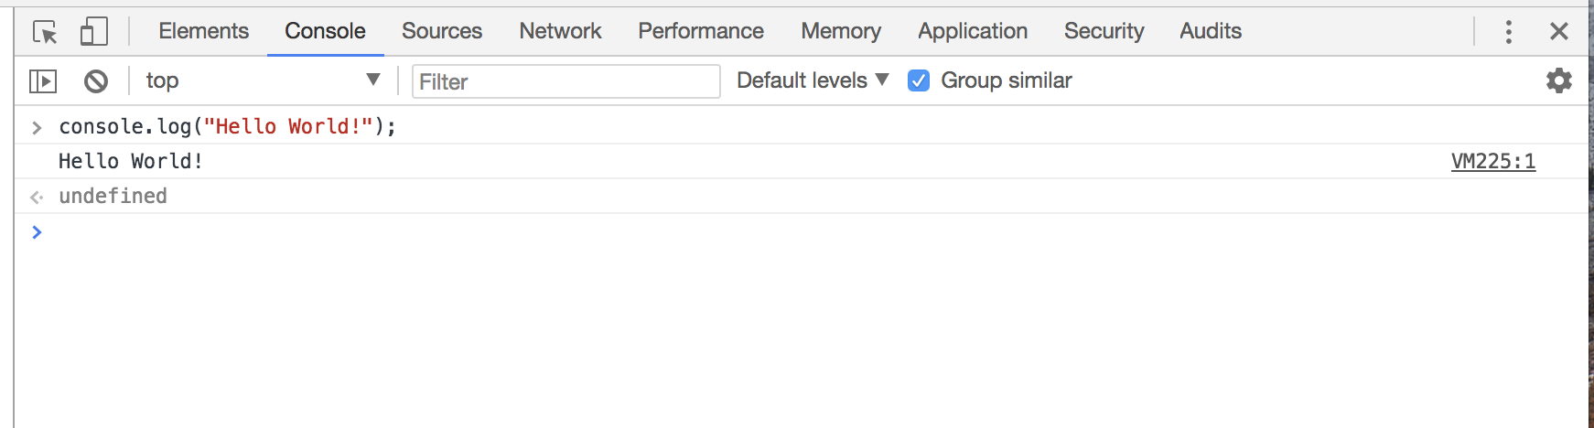

Slide 22
Three Layers of the Web

Slide 23
Keep all of these 3 layers separate !
JavaScript in a .js-file
CSS styling in a .css-file
HTML in a .html-file

Slide 24
Hello world example
https://plnkr.co/edit/?p=preview&preview

Slide 25
Important Guides JS
https://javascript.info/
https://developer.mozilla.org/nl/

Slide 26
Tutorial
https://developer.mozilla.org/en-US/docs/Learn/Getting_started_with_the_web/JavaScript_basics

Slide 27
https://mdn.github.io/beginner-html-site-scripted/
DEMO !!!

Slide 28
Download
https://github.com/mdn/beginner-html-site-styled/archive/gh-pages.zip
Notes:
Calculator: http://embed.plnkr.co/YB9vnC/

Slide 29
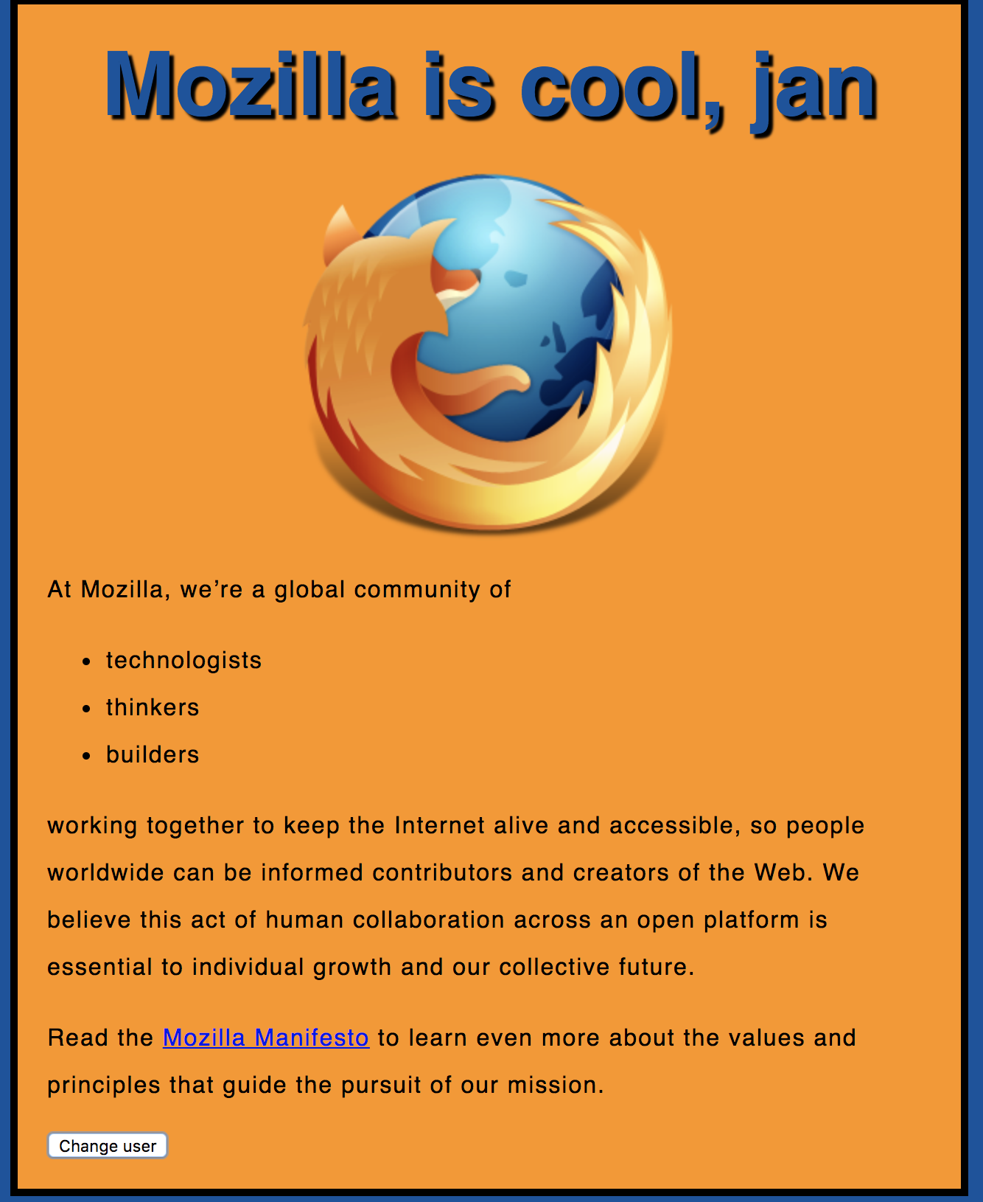
Notes:
https://mdn.github.io/beginner-html-site-scripted/

Slide 30
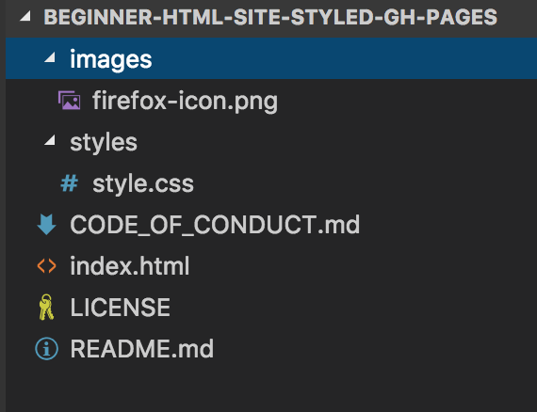

Slide 31
<!DOCTYPE html>
<html>
<head>
</head>
<body>
</body>
</html>
index.html

Slide 32
<!DOCTYPE html>
<html>
<head>
<meta charset="utf-8">
<title>My test page</title>
<link href="styles/style.css" rel="stylesheet" type="text/css">
</head>
<body>
<h1>Hello World!</h1>
<img src="images/firefox-icon.png">
</body>
</html>

Slide 33
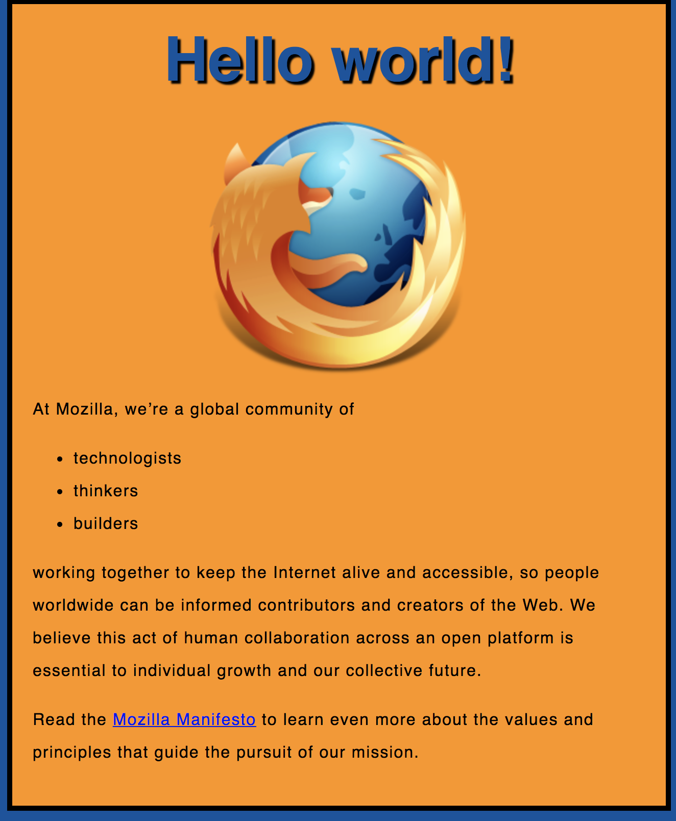
Exercise 1

Slide 34
Exercise 1
Create a new file called main.js
Save it in your scripts folder.

Slide 35
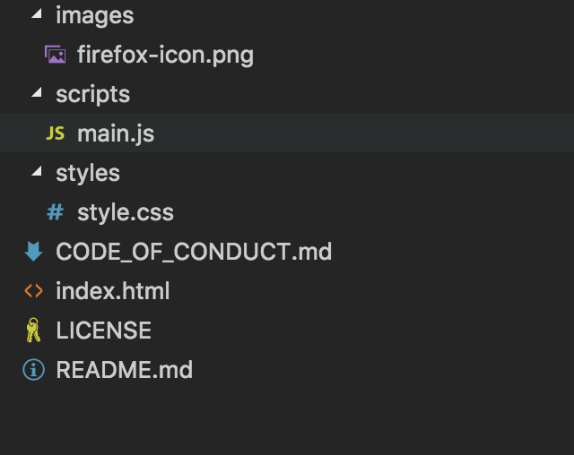

Slide 36
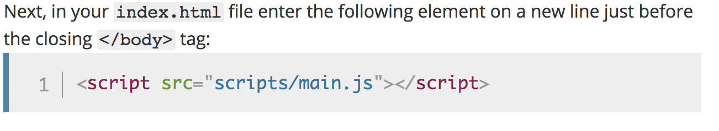
Notes:
<script src="scripts/main.js"></script>

Slide 37
<!DOCTYPE html>
<html>
<head>
<meta charset="utf-8">
<title>My test page</title>
<link href="styles/style.css" rel="stylesheet" type="text/css">
</head>
<body>
<h1>Hello World!</h1>
<img src="images/firefox-icon.png" alt="The Firefox logo: a flaming fox.">
<script src="scripts/main.js"></script>
</body>
</html>
Notes:
Note: The reason we've put the <script> element near the bottom of the HTML file is that HTML is loaded by the browser in the order it appears in the file. If the JavaScript is loaded first and it is supposed to affect the HTML below it, it might not work, as the JavaScript would be loaded before the HTML it is supposed to work on. Therefore, putting JavaScript near the bottom of the HTML page is often the best strategy.

Slide 38
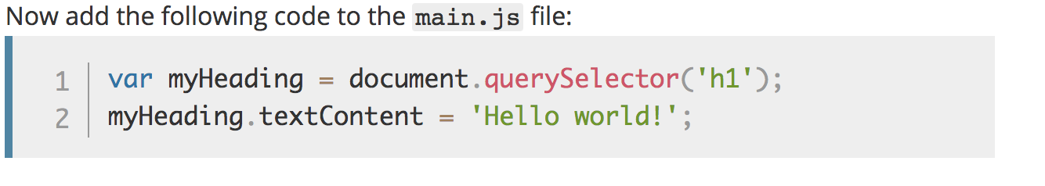
Manipulate HTML/DOM
Notes:
Note: Both of the features you used above are parts of the Document Object Model (DOM) API, which allows you to manipulate documents.
let myHeading = document.querySelector('h1');
myHeading.textContent = 'Hello world!';

Slide 40
Variables

Slide 41
Variables
JavaScript is case-sensitive
var myVar = "foobar";
var MyVar = "foobar";

Slide 42
Variables
var a, b, c;
var a = 3;
var d = 10, e = 10;
f = 22;
var pi = 3.14159;
var s = 'a', t = "t";

Slide 43
Identifiers
Must start with either “$”, “_” or a letter
Subsequent letters can be “$”, “_”, letter, numbers
var 1abc = 3; // Invalid
var $123 = 3; // Valid
Notes:
Identifier = variabelenaam.

Slide 44
Types
“Primitive” value types:
Number (floating point)
String
Boolean
null
undefined
Notes:
null = NIL
undefined= niet geinitializeerd.

Slide 45
Built-in values
true & false
null
undefined
NaN (=Not A Number)
Infinity

Slide 46
Conditionals

Slide 47
Conditionals
if (expression1) {
//Executes when expression1 is truthy
} else if (expression2) {
//Executes when expression2 is truthy
} else {
//Executes when none of the above conditions are truthy
}

Slide 48
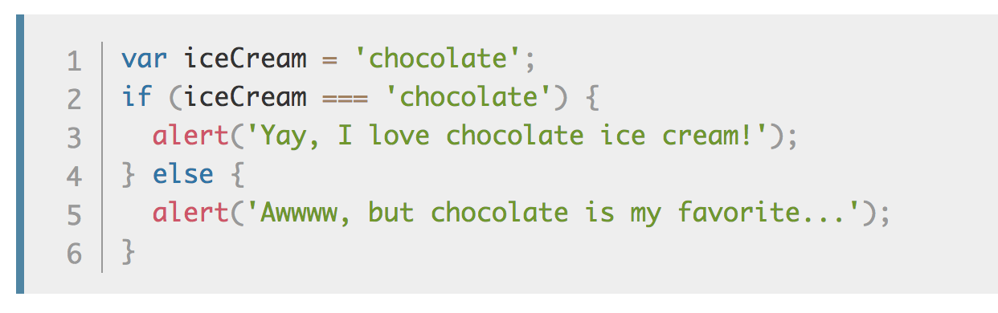
Conditionals

Slide 49
Truthy Falsy
Falsy values:
false, null, undefined, 0, ‘’, NaN
Truthy values:
Everything else

Slide 50
if (null) { // false
} else if (0) { // false
} else if ('') { // false
} else if (1) { // true
}

Slide 51
== vs ===
== performs type coercion
tries to match types for comparison
=== does NOT perform type coercion
will fail if type is different
Notes:
== Coercion: cast gelijk de datatypes.
===

Slide 52
Conditionals

Slide 53
Example
"" === 0 // false
"" == 0 // true
'0' == 0 // true
false == '0' // true
4 != '4' // false
4 !== '4' // true
Try to use ===, !==
instead of ==, !=

Slide 54
Infix operators same as Java
var x = 4;
if (x > 3 && x < 6) {
} else if (x > 3 || x === 2) {
}

Slide 55
Functions

Slide 56
Functions
Functions are objects
Can be created on their own
function foo() {
alert(“HOI”);
}
Can assigned to a variable
var x = function() {}

Slide 57
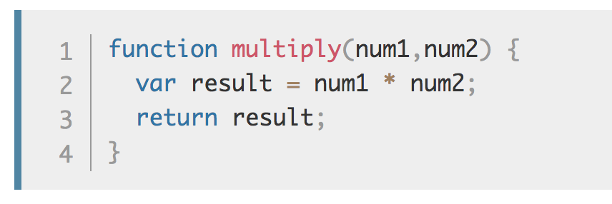
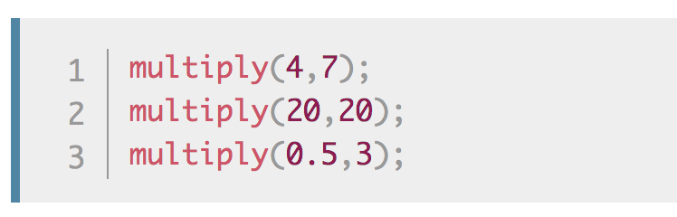
Make your own functions
Notes:
Note: The return statement tells the browser to return the result variable out of the function so it is available to use.
This is necessary because variables defined inside functions are only available inside those functions.
This is called variable scoping.

Slide 58
Events
Examples when Events are executed:
clicked on a button. onClick-event()
clicked on a page
pressed on enter-key

Slide 59
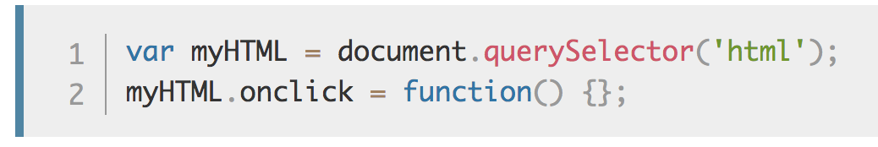
onclick Event

Slide 60
Use “let” or “const” instead of “var”
In modern JavaScript we have 3 ways to declare a variable and assign it a value:
var
let a= 5;
const STATIC1=“ik ben static”
Notes:
See: https://dev.to/mrmario/let-var-const-write-clean-and-safe-code-37hh
https://flaviocopes.com/javascript-difference-let-var/
Var function scoping. Var is a bit more weird, as it has function scoping, which means that variables declared using var are scoped to the nearest function.
Let is block scoping is safer. Niet bekend in de global scope

Slide 61
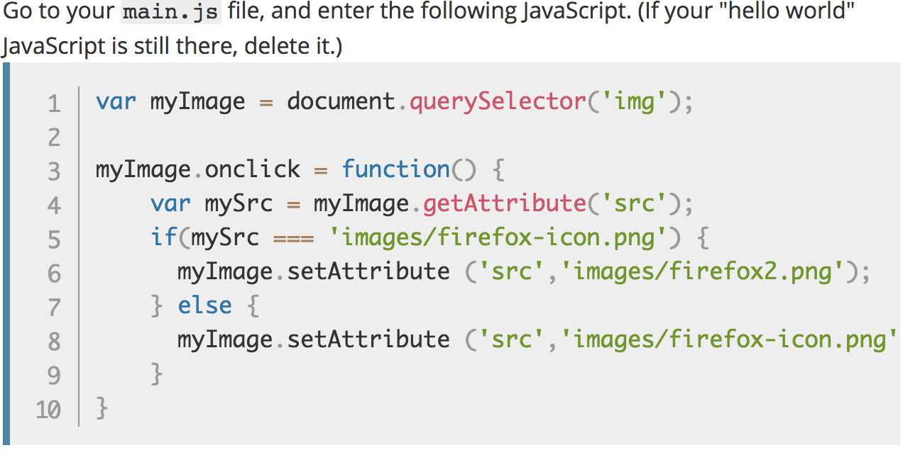
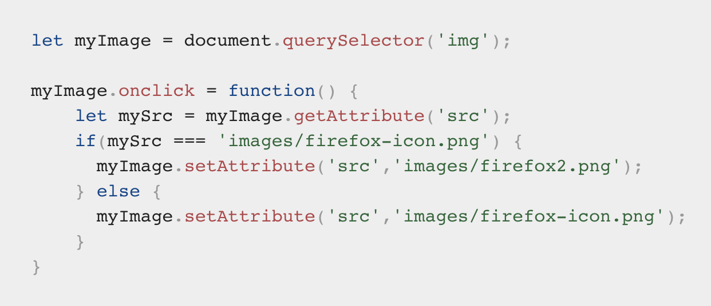
Exercise 2
Notes:
You store a reference to your <img> element in the myImage variable. Next, you make this variable's onclick event handler property equal to a function with no name (an "anonymous" function). Now, every time this element is clicked:
let myImage = document.querySelector('img');
myImage.onclick = function() {
let mySrc = myImage.getAttribute('src’);
if(mySrc === 'images/firefox-icon.png') {
myImage.setAttribute ('src','images/firefox2.png’);
} else {
myImage.setAttribute ('src','images/firefox-icon.png’);
}
}

Slide 62
Exercise 3
Adding a personalized welcome message

Slide 63
Notes:
https://mdn.github.io/beginner-html-site-scripted/

Slide 64
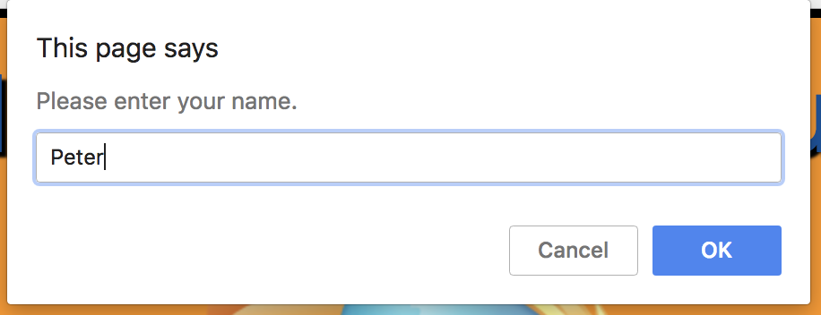

Slide 65
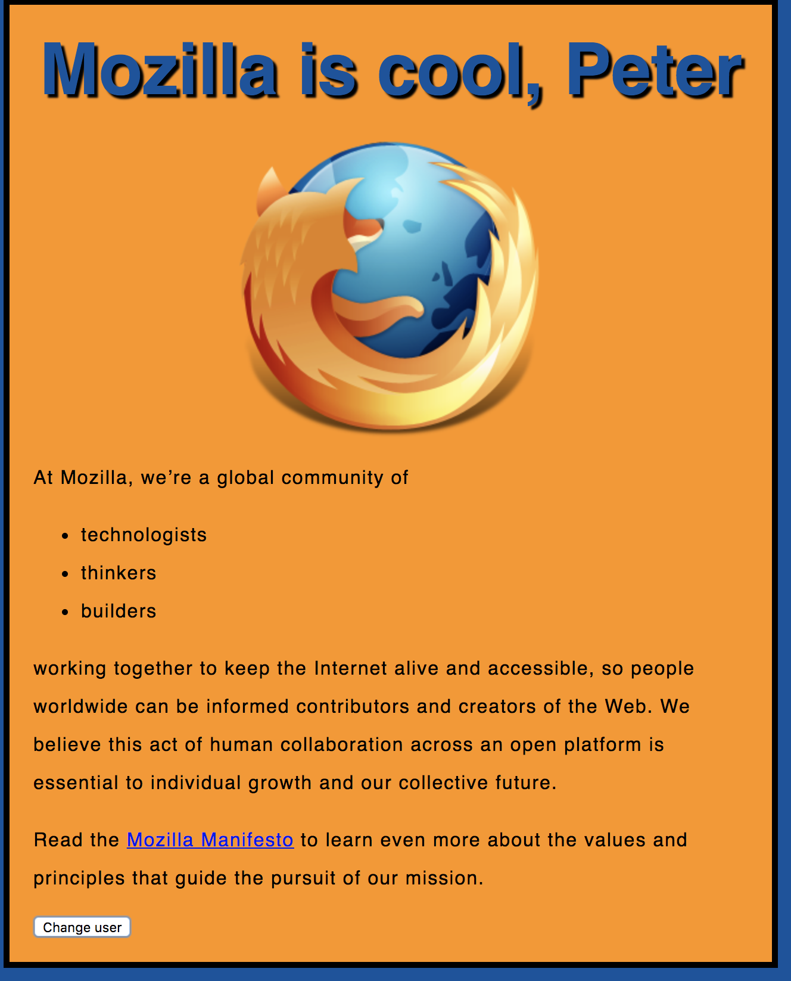

Slide 66
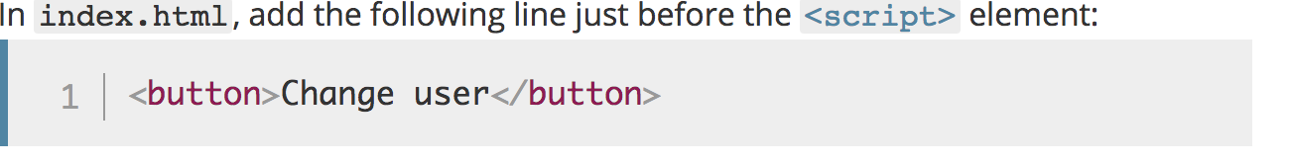

Slide 67
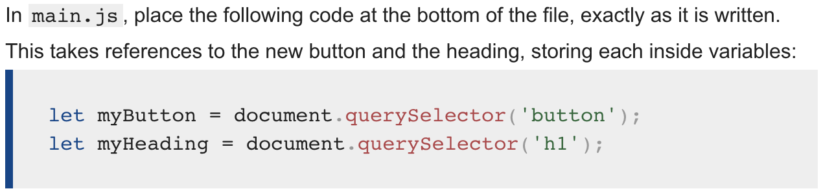
Notes:
let myButton = document.querySelector('button’);
let myHeading = document.querySelector('h1');

Slide 68
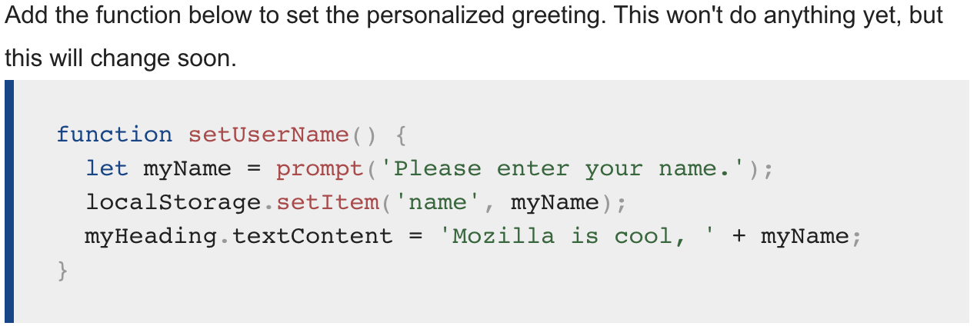
Notes:
function setUserName() {
let myName = prompt('Please enter your name.');
localStorage.setItem('name', myName);
myHeading.innerHTML = 'Mozilla is cool, ' + myName;
}

Slide 69
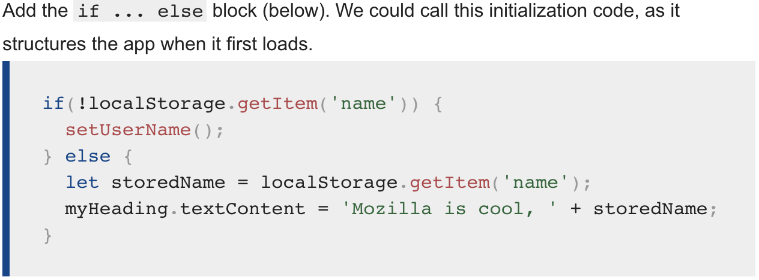
Notes:
if(!localStorage.getItem('name')) {
setUserName();
} else {
let storedName = localStorage.getItem('name');
myHeading.innerHTML = 'Mozilla is cool, ' + storedName;
}

Slide 70
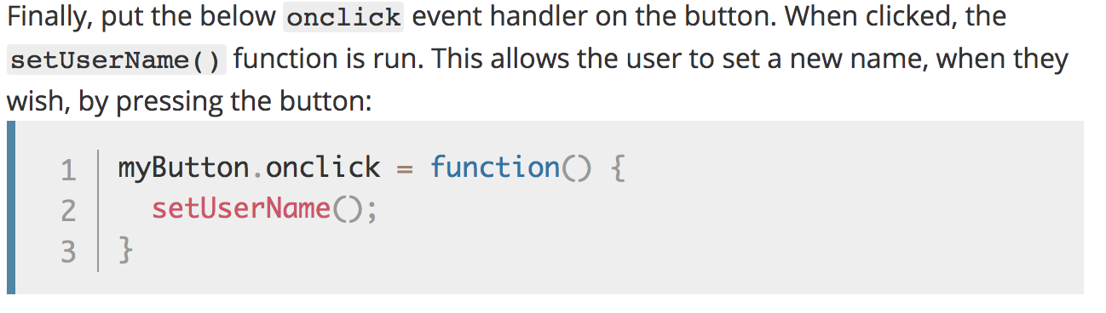
Notes:
myButton.onclick = function() {
setUserName();
}

Slide 71
Solution
https://github.com/mdn/beginner-html-site-scripted/blob/gh-pages/scripts/main.js

Slide 72
Iterators/ Loops

Slide 73
Iterators
while (expression) { .. }
for (init; expression; update) { .. }
for (variable of object) { .. }
for (variable in object) { .. }

Slide 74
let list = [4, 5, 6];
for (let in list) { console.log(i); // "0", "1", "2" }
for (let i of list) { console.log(i); // "4", "5", "6" }

Slide 75
Arrays

Slide 76
Arrays
let beers = ['Heineken', 'Amstel', 'Jupiler’];
let cars = new Array("Saab", "Volvo", "BMW");
console.log(beers.length); // output is 3
let x = beers[0]; // x => 'Heineken'

Slide 77
Arrays
let beers = ['Heineken', 'Amstel', 'Jupiler'];
beers[5] = 'Palm';
console.log(beers.length); // output is 6 (!)
console.log(beers[3]); // output is undefined (!)
beers = [ , 'Heineken', , 'Amstel'];
console.log(beers.length); // output is 4 (!)

Slide 78
Objects

Slide 79
Objects
let car = new Object();
car.make = 'Ford';
car.model = 'Mustang';
car.year = 1969;

Slide 80
Associative Array /
Dictionary
let car = new Object();
car['make'] = 'Ford';
car['model'] = 'Mustang';
car['year'] = 1969;

Slide 81
JSON
let car = {
make: 'Ford',
model: 'Mustang',
year: 1969
};

Slide 82
JSON

Slide 83
JSON
JavaScript Object Notation
A common use of JSON is:
to exchange data to/from a web server.

Slide 84
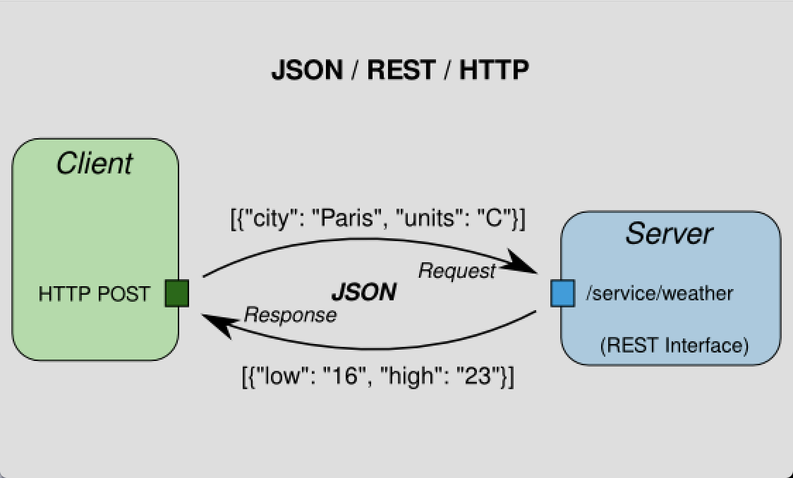

Slide 85
Valid JSON
let obj = {
"name":"John",
"age":30,
"city":"New York”
};

Slide 86
JSON
For parsing use:
var json = JSON.parse('{..}')
var jsonString = JSON.stringify({..});
Notes:
PARSE:
When receiving data from a web server, the data is always a string.
Parse the data with JSON.parse(), and the data becomes a JavaScript object.
STRINGIFY:
When sending data to a web server, the data has to be a string.
Convert a JavaScript object into a string with JSON.stringify().

Slide 88
JSON.parse( )
Parse the data with JSON.parse(), and the data becomes a JavaScript object.
See: https://www.w3schools.com/js/js_json_parse.asp

Slide 89
JSON.stringify( )
Convert a JavaScript object into a string with JSON.stringify().
See: https://www.w3schools.com/js/js_json_stringify.asp

Slide 90
Debugging in Chrome

Slide 91


Slide 92
Node.js provides a JavaScript runtime environment

Slide 93
Goals
Provide a JavaScript runtime environment
Event-driven, non-blocking I/O
fast/lightweight

Slide 94
Applications
Can be used to create Tools, applications or services
Powered by Chrome’s V8 JavaScript engine
npm, package ecosystem

Slide 95

History
First written in 2009
By Ryan Dahl
2010 package manager npm
2011 native Windows version

Slide 96
Utilities
Node comes with the following:
I/O, Sockets(http/dns/udp/etc), crypto functions, data streams
Runs on Linux, Mac, Windows

Slide 97
Opdracht Node
Open map:
2- Node
Opdracht:
Implement a directory walker

Slide 98
Opdracht Node
How to read recursively a directory in Node.js

Slide 99
Readme
Open Readme for instructions

Slide 100
Package.json
Package.json is important for NPM.
With this file you can declare all your dependencies and install them.

Slide 101
Step 1
Open your prompt/shell/terminal in the root directory
and type: `npm install --save filewalker`

Slide 102
What is generated
A couple of things have happened:
NPM installed the `filewalker` dependency locally in the node_modules folder
NPM add `filewalker` to the dependency list in package.json

Slide 103
Great!
This means that we are now able to use this dependency.

Slide 104
Step 2 Use the dependency
Open:
`nodeScript.js`

Slide 105
First we need to require the dependency.
Add the following in your nodeScript:
const filewalker = require('filewalker');

Slide 106
Step 3
Using the following code we can traverse a directory:
filewalker('A_DIRECTORY')
.on('dir', p => console.log('dir: %s', p))
.walk();

Slide 107
Step 4 Execute script
node nodeScript.js

Slide 108
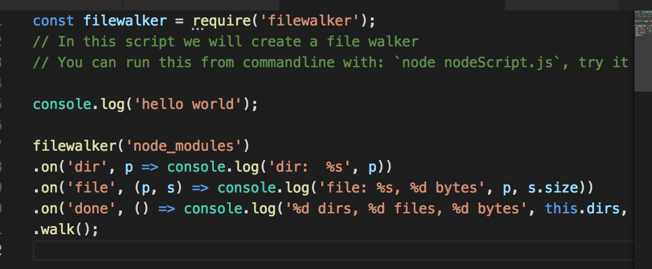
Notes:
filewalker('node_modules')
.on('dir', p => console.log('dir: %s', p))
.on('file', (p, s) => console.log('file: %s, %d bytes', p, s.size))
.on('done', () => console.log('%d dirs, %d files, %d bytes', this.dirs, this.files, this.bytes))
.walk();

Slide 109
Exercise create REST-API
https://www.codementor.io/wapjude/creating-a-simple-rest-api-with-expressjs-in-5min-bbtmk51mq

Slide 110
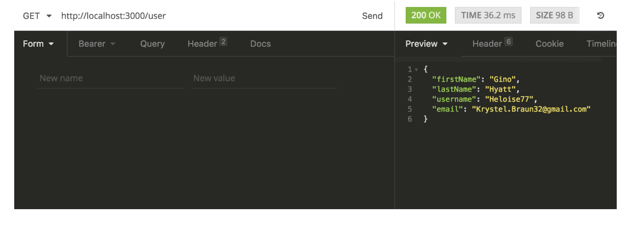

Slide 111
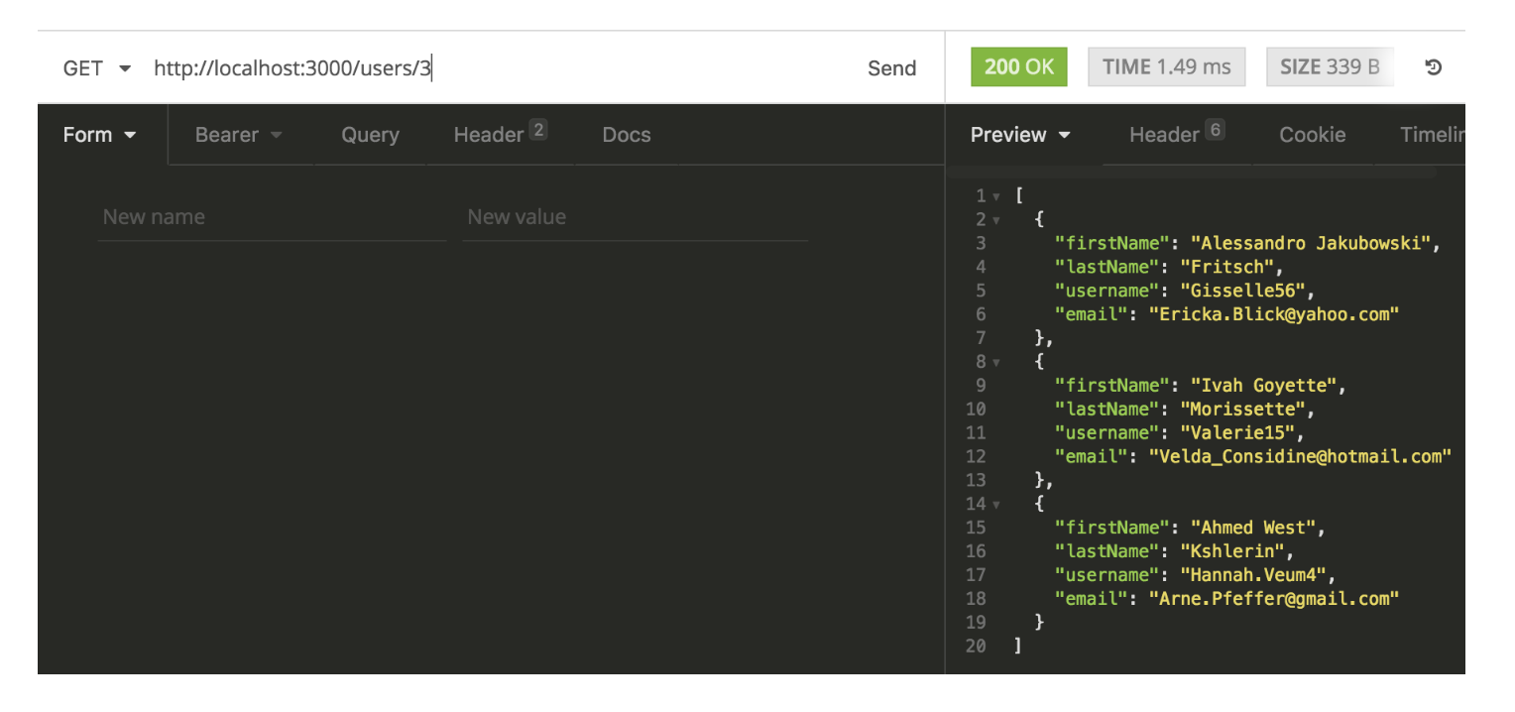

Slide 112
Building blocks
Node.js
ExpressJS: for REST API
body-parser
Faker: generate random user account details

Slide 113
Async Programming
Notes:
Voorbeeld Whatsapp. Async communcatie met messaging.
Why Axios?

Slide 114
What is HTTP?
HTTP works as a request-response protocol between a client and server.
Notes:
A web browser may be the client, and an application on a computer that hosts a web site may be the server.
Example: A client (browser) submits an HTTP request to the server; then the server returns a response to the client. The response contains status information about the request and may also contain the requested content.

Slide 115
HTTP Methods
GET
POST
PUT
HEAD
DELETE
PATCH
OPTIONS

Slide 116
GET Method
GET is used to request data from a specified resource over HTTP.

Slide 117
POST Method
POST is used to send data to a server to create/update a resource.

Slide 118
PUT is idempotent
https://developer.mozilla.org/en-US/docs/Glossary/Idempotent
Notes:
An idempotent method means that the result of a successful performed request is independent of the number of times it is executed.

Slide 119
HTTP Request Methods
https://www.w3schools.com/tags/ref_httpmethods.asp

Slide 120
Exercise

Slide 121
Sync vs Async Programming
Notes:
Voorbeeld Whatsapp. Async communcatie met messaging.
Why Axios?

Slide 122
Async Programming
By sending asynchronously, the JavaScript does not have to wait for the server response, but can instead:
execute other scripts while waiting for server response
deal with the response after the response is ready

Slide 123
Promise Syntax
Service.get()
.then(x => console.log(x)) → onsucces
.catch(error => console.log(error)) → onerror

Slide 124
Async with AXIOS
Promise based HTTP client for the browser

Slide 125
CORS
Cross-Origin Resource Sharing (CORS) is a technique for relaxing the same-origin policy, allowing Javascript on a web page to consume a REST API served from a different origin.

Slide 126
CORS

Slide 127
CORS
Notes:
This mechanism prevents attackers that plant scripts on various websites (eg. in ads displayed via Google Ads) to make an AJAX call to www.yourbank.com
and in case you were logged in making a transaction using *your* credentials.

Slide 128
Exercise Full stack 1 + 2
https://itnext.io/learn-how-full-stack-apps-work-by-building-a-simple-one-using-javascript-part-1-38e237694012
https://
Notes:
https://codeburst.io/build-a-weather-website-in-30-minutes-with-node-js-express-openweather-a317f904897b

Slide 129
configure the CORS
see: www.npmjs.com/package/cors

